Slide 1
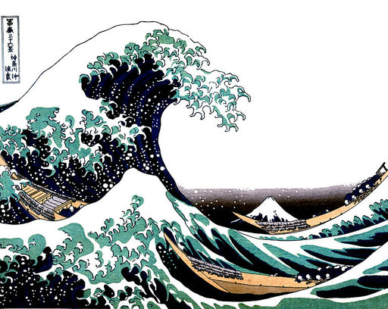
Tsunami Sirens
Curry County Emergency Management

Slide 2
What is a Tsunami?
Hint: The above image is NOT a real tsunami.

Slide 3
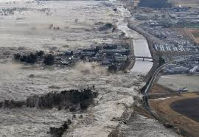
Local Tsunami
Generated by very large earthquake in our subduction zone
Displaced ocean water pushes inland in a series of tidal surges
40 Magnitude 8–9.0+ earthquakes along Cascadia over past 10,000 years
Last local tsunami: January 26th, 1700

Slide 4
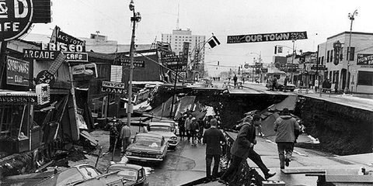
IF THE GROUND SHAKES…
The ground shaking IS your warning!
Government warning systems may fail during a Cascadia Earthquake!
Evacuate Evacuate Evacuate

Slide 5
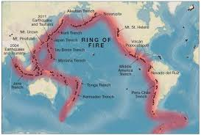
Distant Tsunami
Generated by large subduction earthquake in a distant location
Distant tsunamis generated in Chile, Japan, Kamchatka, Alaska
Since 1933, 31 distant tsunamis have been observed along and
near Curry County

Slide 8
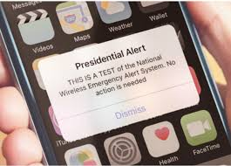
Public Warning Systems

Slide 9
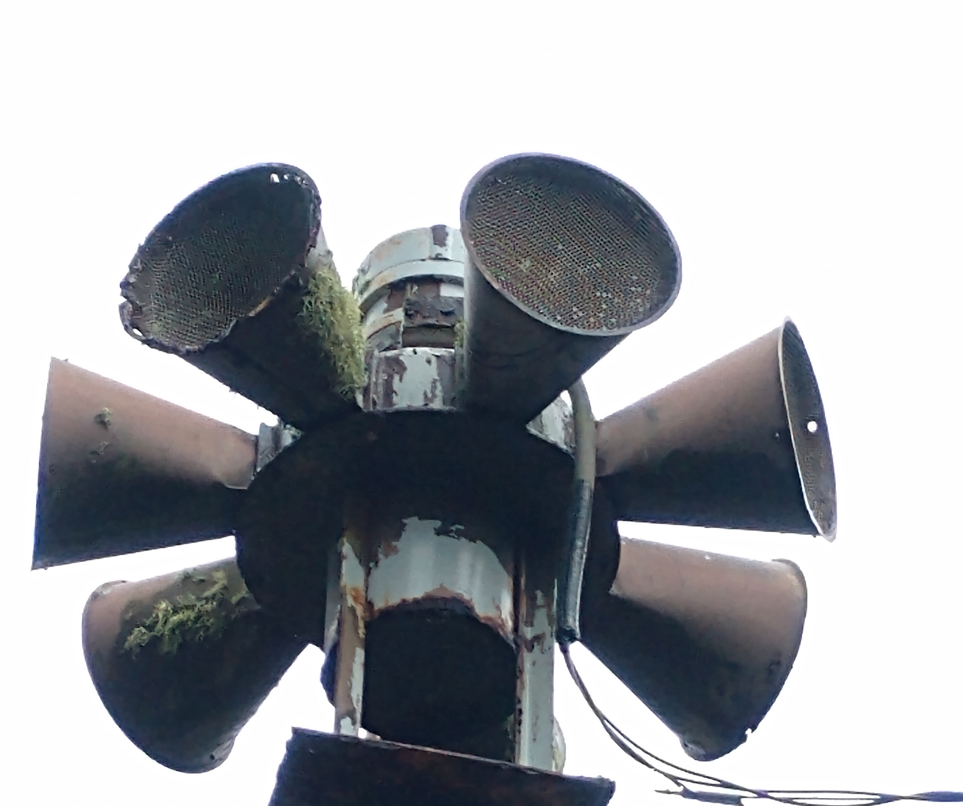
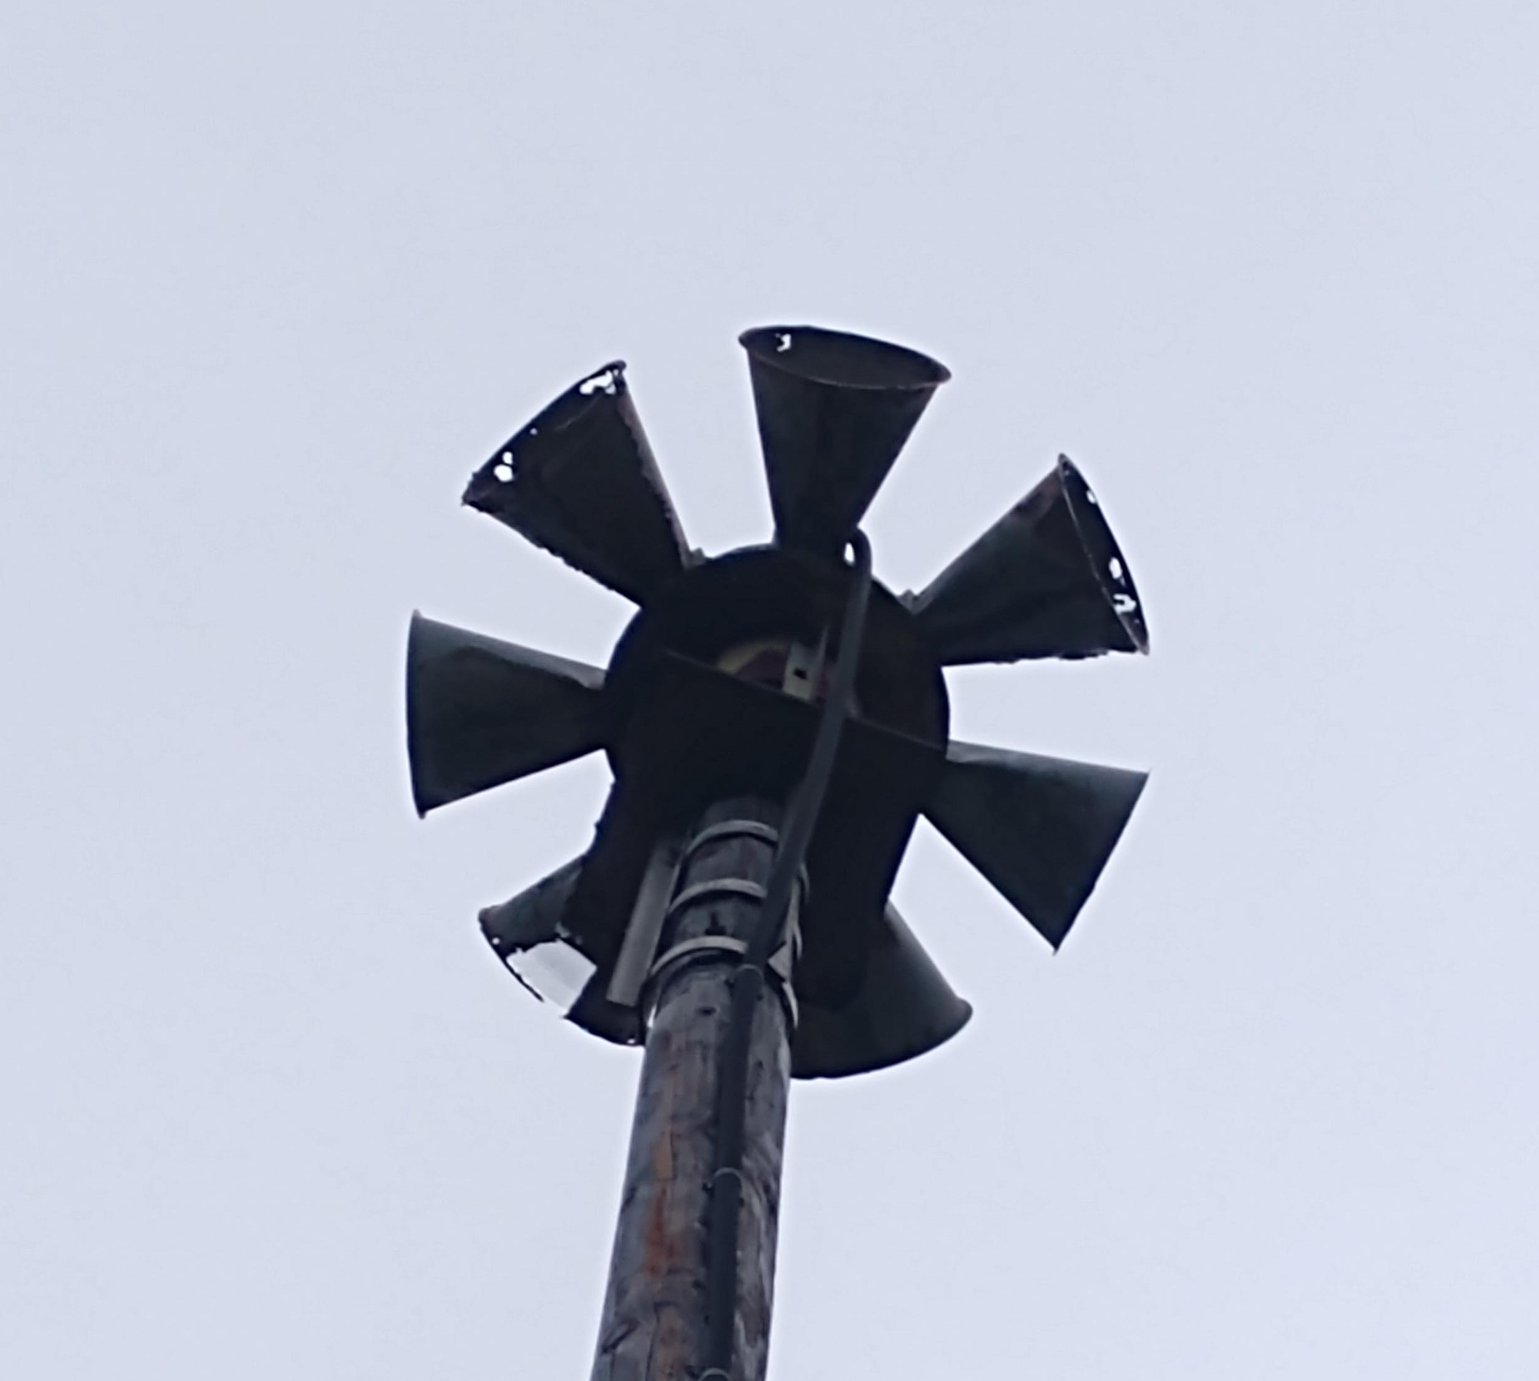
Tsunami Sirens
17 Tsunami sirens in Curry County
2 have been repaired in past 18 months (Port Orford, Harris Beach)
4 currently operational

Slide 10
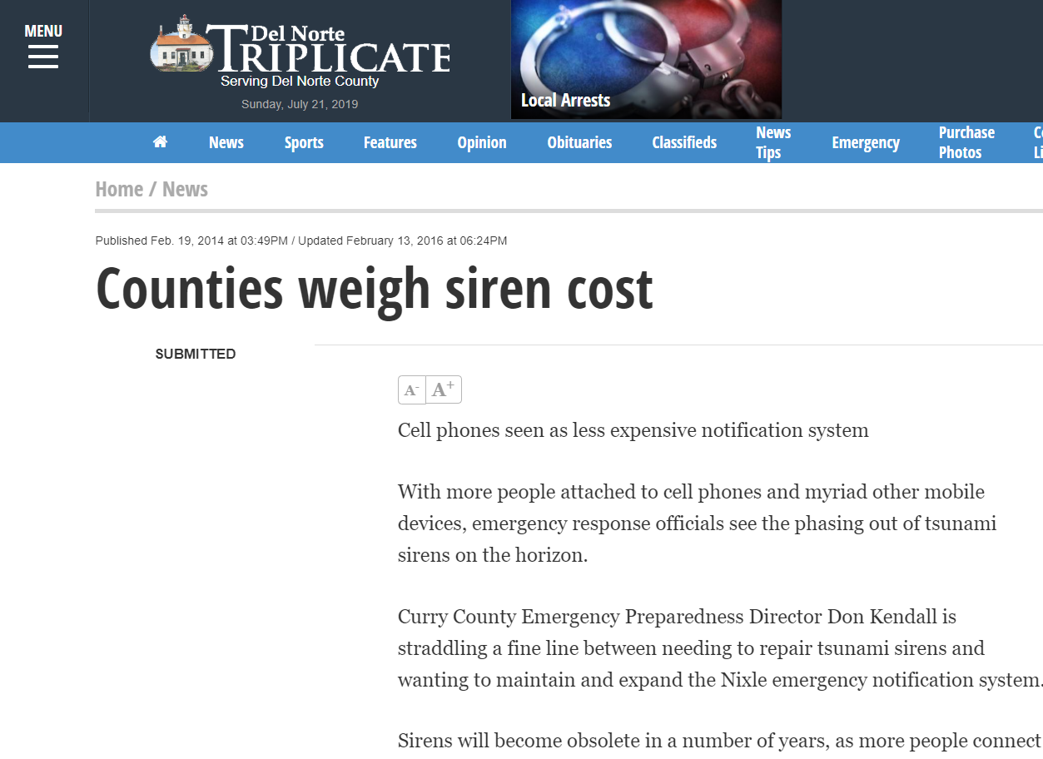

Slide 11
“A number of years ago there were +/- 32 sirens along coastal Tillamook. After the new charts came out, and our findings and experience with the Japan incident, a committee submitted their findings and the siren owners in the county chose to no longer support this very old technology as the cost/benefit ratio just didn't justify their continued upkeep and/or replacement, opting for the newer ways of notifications. There are a few remaining sirens that are used by Fire Departments to activate their volunteers, and a summer camp to call in their folks, otherwise, they have all been removed.”
“Lincoln County has zero under our jurisdiction. We do not support distant tsunami sirens as technology will work and there is ample time to do door to door notifications and assist the public to evacuate. Distant tsunami zone is very small and risk to public is low for life safety.”

Slide 13
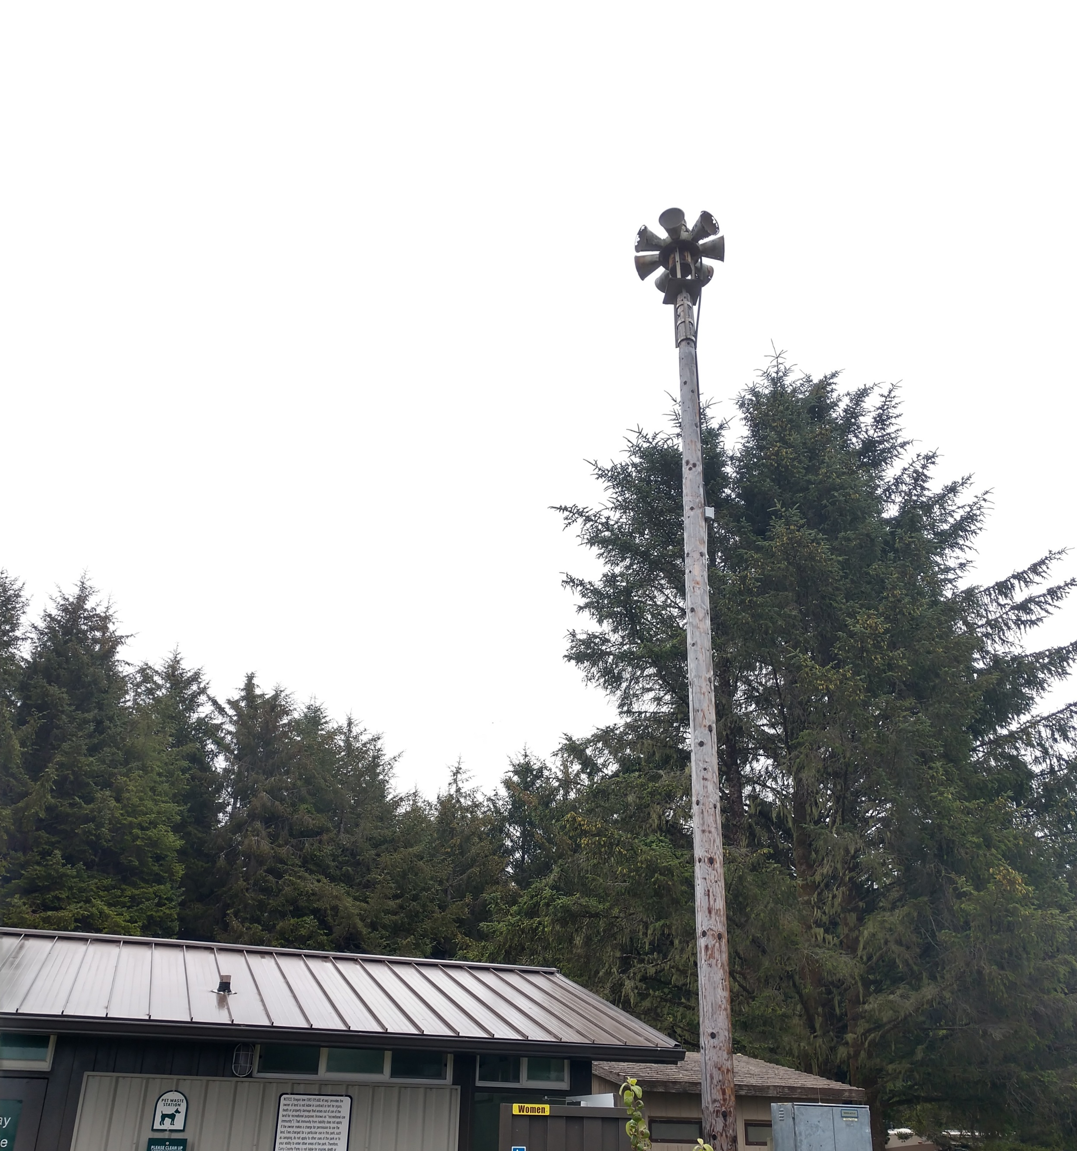
Cost to replace siren head at Boice Cope: $22,000

Slide 14
Cost to repair / replace sirens excessive versus benefit and capability
Oregon Counties have discontinued use
Multiple warning systems currently in place
Minimum lead time of 4 hours for distant tsunami
Recommendation: Discontinue County use of tsunami sirens.

